Slide 1
PITCH DECK
Ronja Friman
Cristian Robu

Slide 2
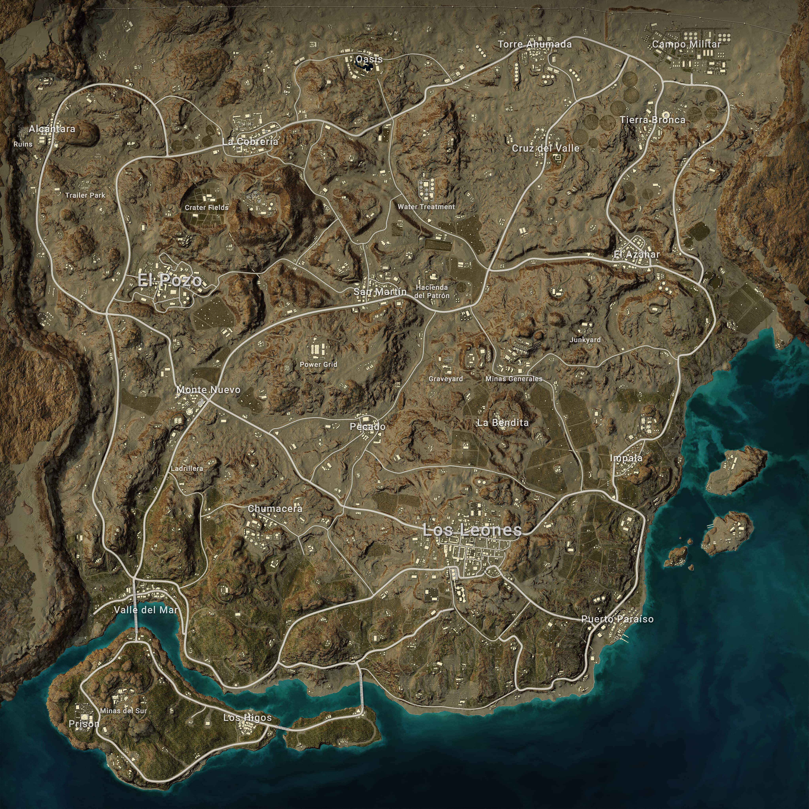
Problem
Using PUBG’s miramar map to obtain a AI model that will give ideas of new maps with the same player experience

Slide 3
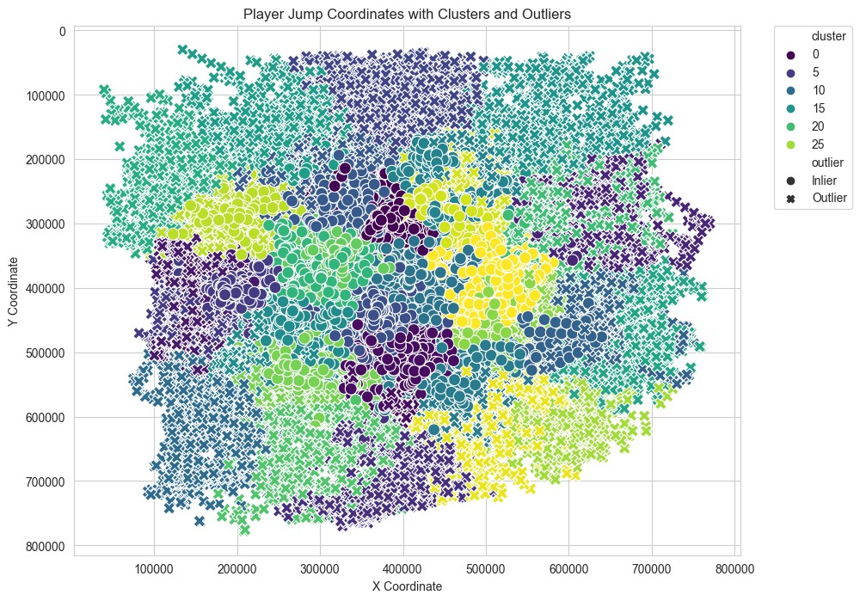
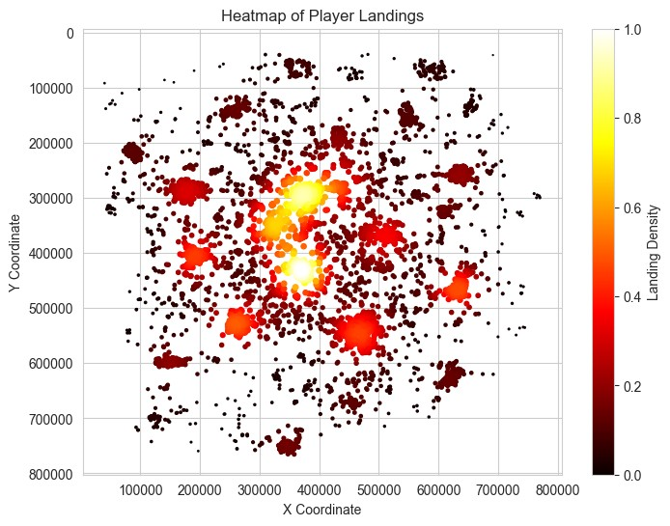
First Steps

Slide 4
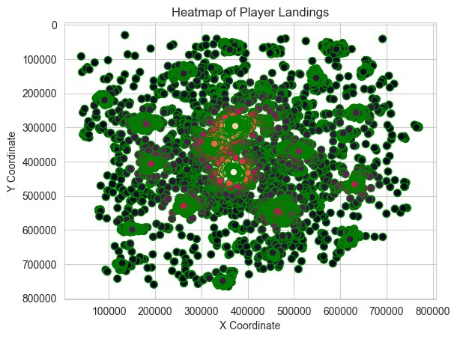
First Steps

Slide 5
Next steps
Introduce new variables and create statistical models identifying which variables are useful to use or not and which ones influence players behaviour more

